Slide 1
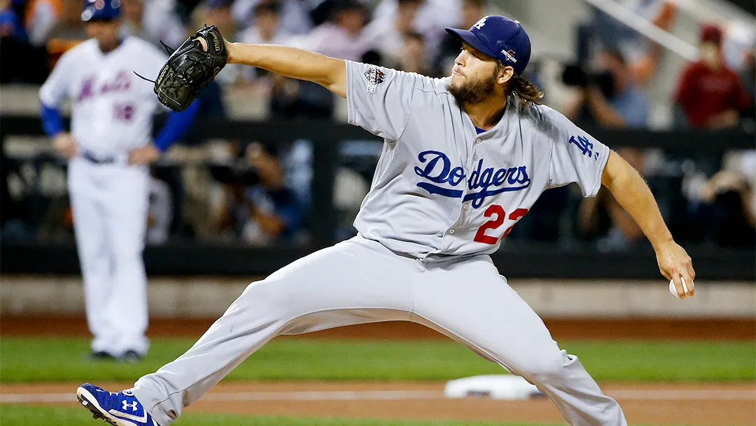

Slide 2
SIMILARITIES
Both are team sports
Both sports require a bat and a ball
Both have batters and pitchers/bowlers
Both sports have similar scoring systems (runs)
Both have similar ways in which the batter can get out
In both sports roles rotate once a certain number of outs are reached
In Baseball as well as in cricket the main objective is to score runs

Slide 3
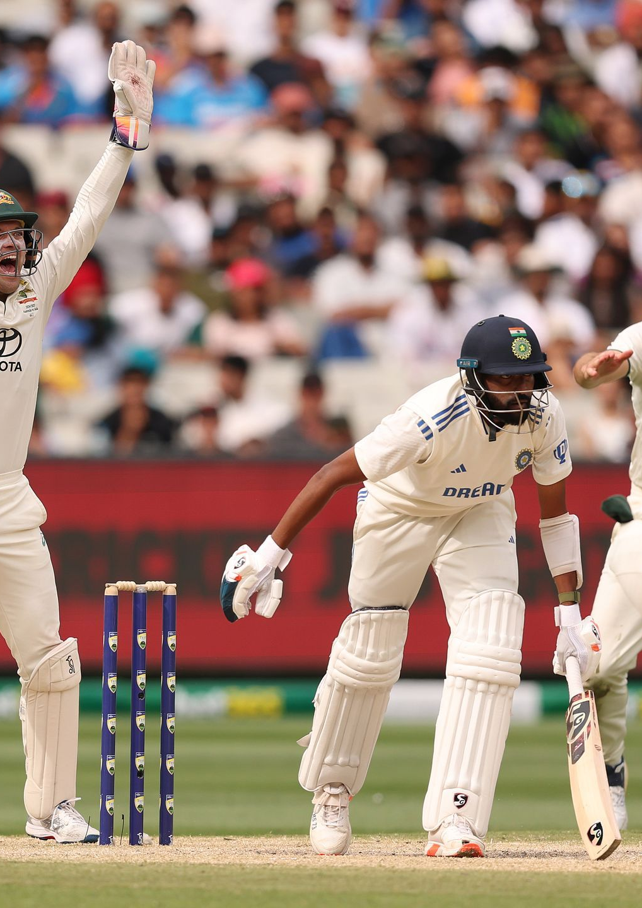
DIFFERENCES
Baseball is larger than a cricket ball whereas a cricket ball is heavier
Baseball bat is almost cylindrical in shape while a cricket bat is more paddle-shaped
In cricket there are pickets behind the batter and in baseball there are none
In baseball the distance between the batter and the pitcher is 60ft while in cricket the distance is 66ft
In baseball the ball is thrown straight at the batter and and in cricket it’s thrown at the ground, so it bounces before he can hit it
The area of play in baseball is only the diamond-shaped field in front of the batter, on the other hand cricket is played on an oval-shaped field

Slide 4
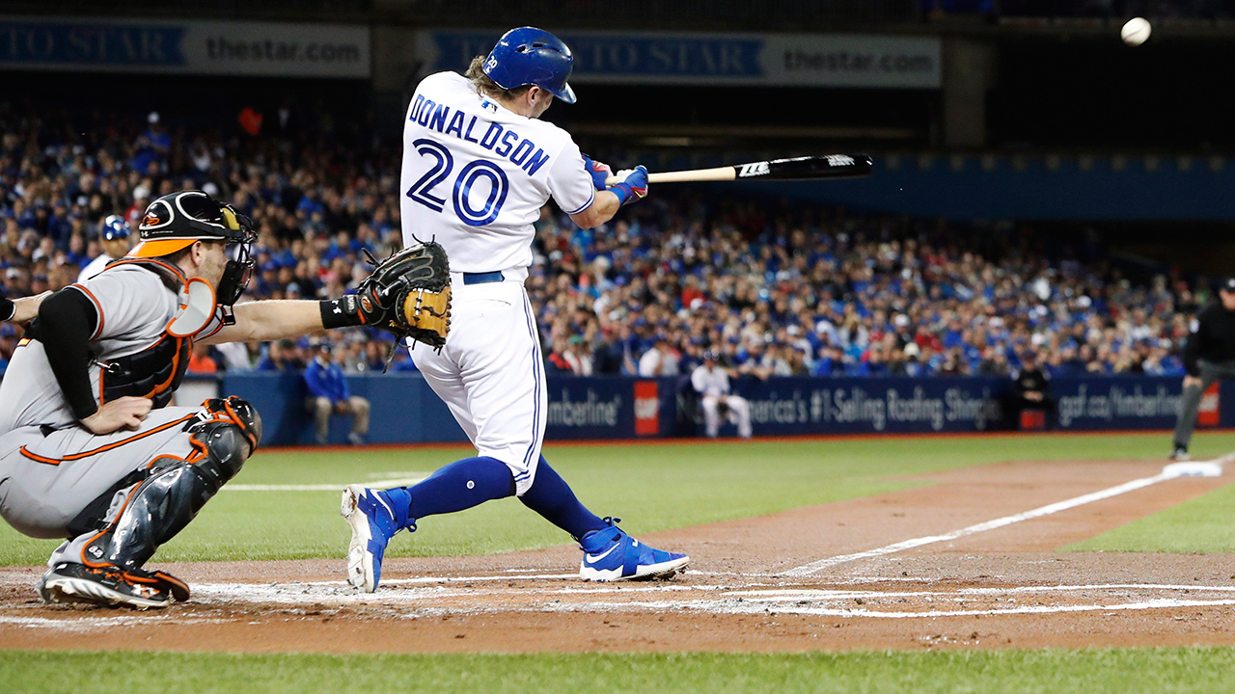
RULES OF BASEBALL
Teams: 2 teams of 9 players each.
Objective: Score runs by hitting the ball and running around 4 bases to reach home plate.
Innings: A game consists of 9 innings; each team bats once per inning.
Outs: A batting team continues until 3 outs are made.
Pitching and Hitting: A pitcher throws the ball to the batter, who tries to hit it.
Runs: A run is scored when a player runs around all bases and returns to home plate.
Strikes and Balls: A batter is out after 3 strikes; 4 balls earns a walk (free base).
Fielding: The fielding team tries to get batters out by catching the ball, tagging runners, or forcing them out at bases.
Home Run: A ball hit over the outfield fence in fair territory scores an automatic run (and any runners on base).

Slide 5
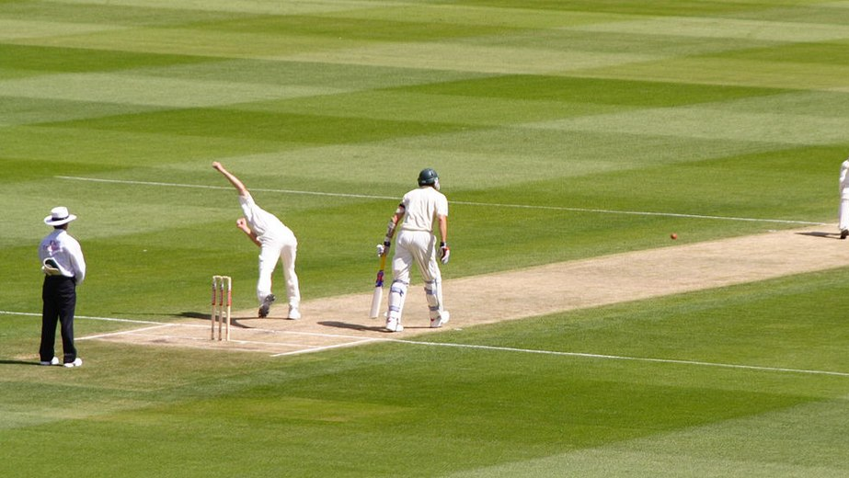
RULES OF CRICKET
Teams: 2 teams of 11 players each.
Objective: Score runs by hitting the ball and running between two wickets.
Innings: Each team bats once or twice (depending on the format).
Overs: An over consists of 6 legal deliveries. The number of overs per team depends on the format (e.g., 20 in T20, 50 in ODIs).
Batting: Two batters are on the field. They score by running between wickets or hitting boundaries (4 or 6 runs).
Wickets (Outs): Each team bats until 10 of the 11 players are out.
Bowling: A bowler delivers the ball to try and get the batter out (bowled, caught, LBW, run out, etc.).
Runs: Scored by running between the wickets or by hitting boundaries (4 = ball reaches boundary; 6 = ball clears it).
Fielding: Fielders aim to limit runs and take wickets by catching, running batters out, etc.

Slide 6

TOURNAMENTS
CRICKET
🏆 1. ICC Cricket World Cup
🌍 2. ICC T20 World Cup
🇮🇳 3. Indian Premier League (IPL)
🏏 4. The Ashes (England vs Australia)
🌍 5. ICC World Test Championship
BASEBALL
🏆 1. Major League Baseball (MLB) – USA & Canada
🌎 2. World Baseball Classic (WBC)
🇯🇵 3. Nippon Professional Baseball (NPB) – Japan
🇰🇷 4. KBO League – South Korea

